Slide 1
Education and Engagement Template
Round One

Slide 2
A Greater Baltimore Region
Involving community residents in the Opportunity Collaborative

Slide 3
Introduction
What does opportunity mean to you?

Slide 4
The Opportunity Collaborative
Regional Planning Effort
25+ Consortium Members
Values based on Livability Principles
Funded by $3.5M federal grant
Government, nonprofits and community working together

Slide 5
Our Values The Livability Principles
Provide more transportation choices
Promote equitable affordable housing
Enhance economic competitiveness
Support existing communities
Coordinate policies and leverage investments
Value communities and neighborhoods
Protect the Chesapeake Bay*

Slide 6
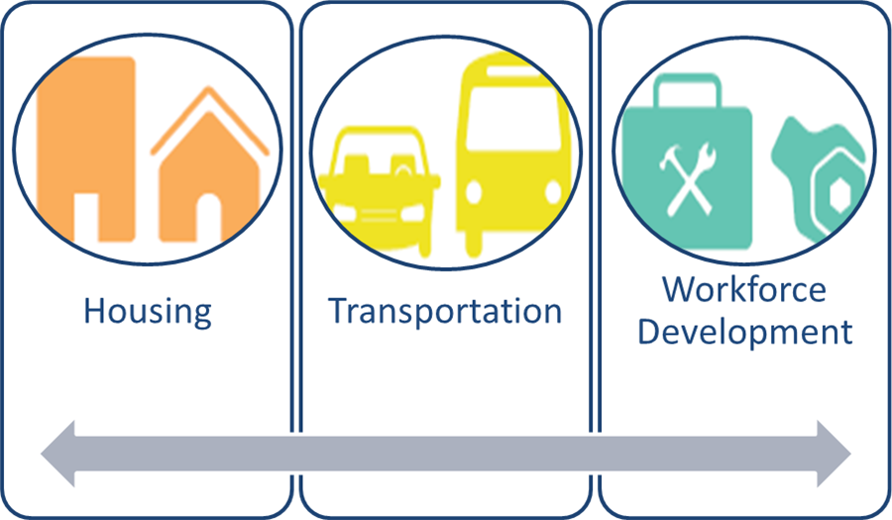
What We’re Doing
Developing a common vision for…
and a greater Baltimore Region.

Slide 7
Why is This Important?
The Baltimore region has tremendous resources – but not everyone has the same access to the opportunities that are available.

Slide 8
Prosperous Region

Slide 9
Well-Educated Region

Slide 10
Job Growth

Slide 11
Top Area Employers
Fort Meade
Johns Hopkins Univ. & Medical
Aberdeen Proving Ground
Social Security Admin.
University of Maryland

Slide 12
Income Disparities

Slide 13
College Degree Disparities

Slide 14
Racial & Geographic Lines

Slide 15
Why is This Important?
If we are to succeed as a region, we must determine how to connect every community to opportunity.

Slide 16
Addressing our Challenges
Your involvement will make a difference
Notes:
we are asking for input from everyone involved to help us create those strategies – including you. These sessions are a part of the process.

Slide 17
What Can We Achieve Working Together
Improved Access to Jobs and Housing
Improved Quality of Life for All
Stronger Communities
New Partnerships – Government, Nonprofits and Businesses Working Together

Slide 18
What Happens if We Do Nothing
Missed Opportunity
Missed opportunity to address barriers to workforce development
Missed opportunity to address access to transit and housing
Missed opportunity to work together to address mutual challenges

Slide 19
Moving Forward

Slide 20
We Need Your Expertise!
What does opportunity mean to you?

Slide 21
We Need Your Expertise!
What prevents you from being connected to opportunity?

Slide 22
We Need Your Expertise!
How can we all work together to get people and communities better connected to opportunity?

Slide 23
What’s Next?
Stay engaged in the process
Through partner organizations
Through opportunitycollaborative.org
On Facebook and Twitter (@OpportunityColl)
Become a leader for your community
More…

